Slide 1
GIT LAB Merge Request
Creating Merge Request

Slide 2
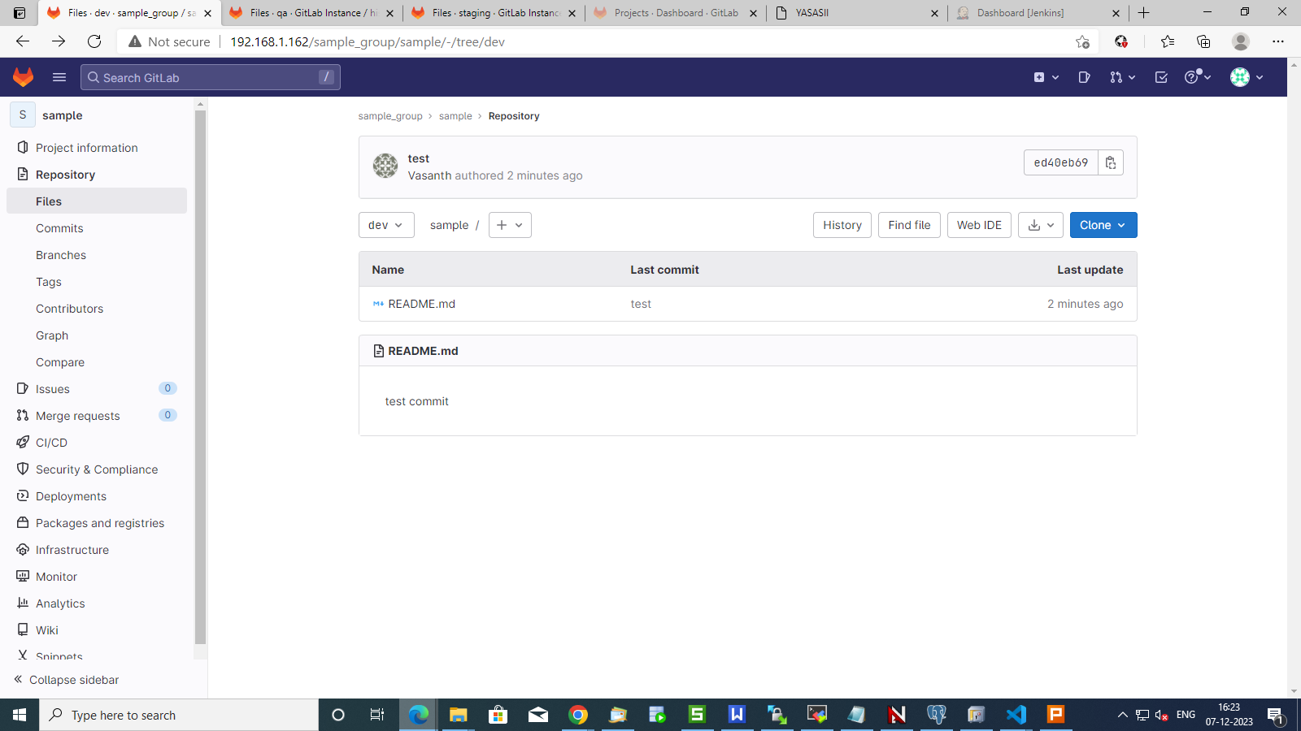

Slide 3
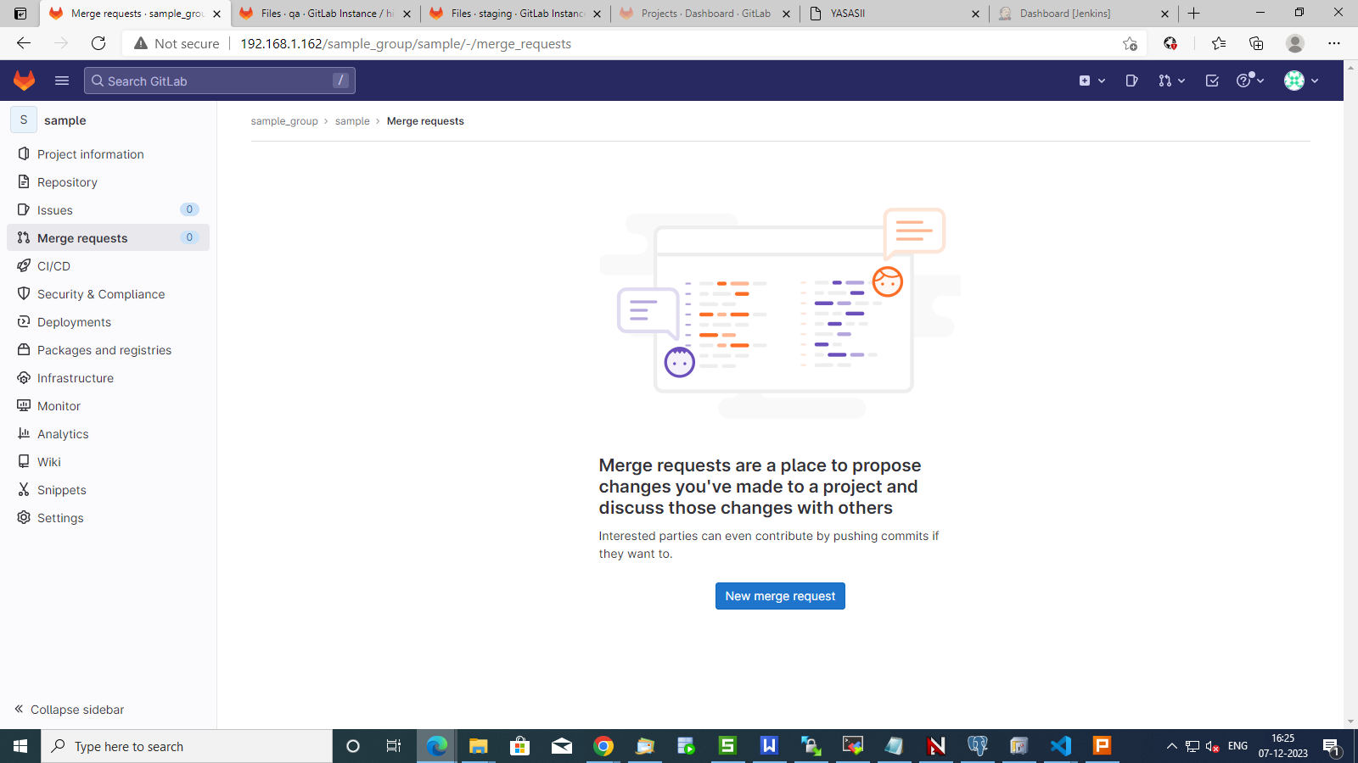

Slide 4
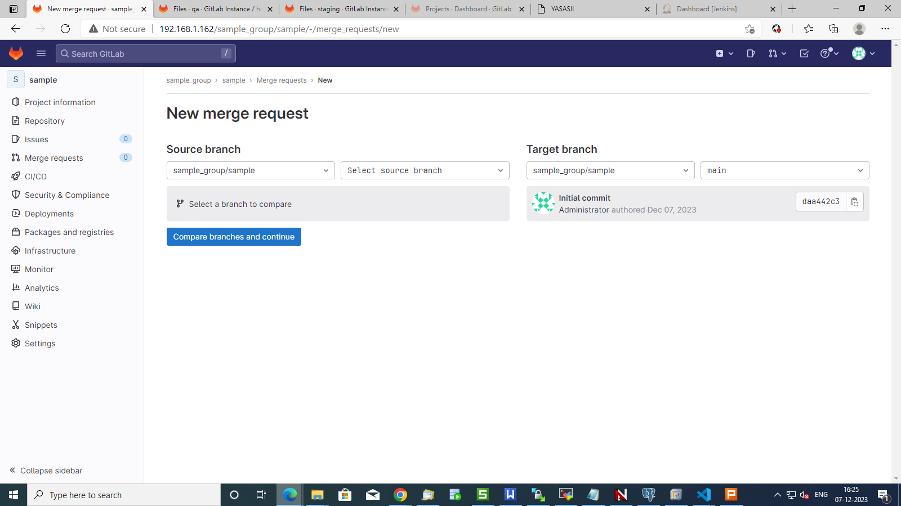
1
2
3

Slide 5
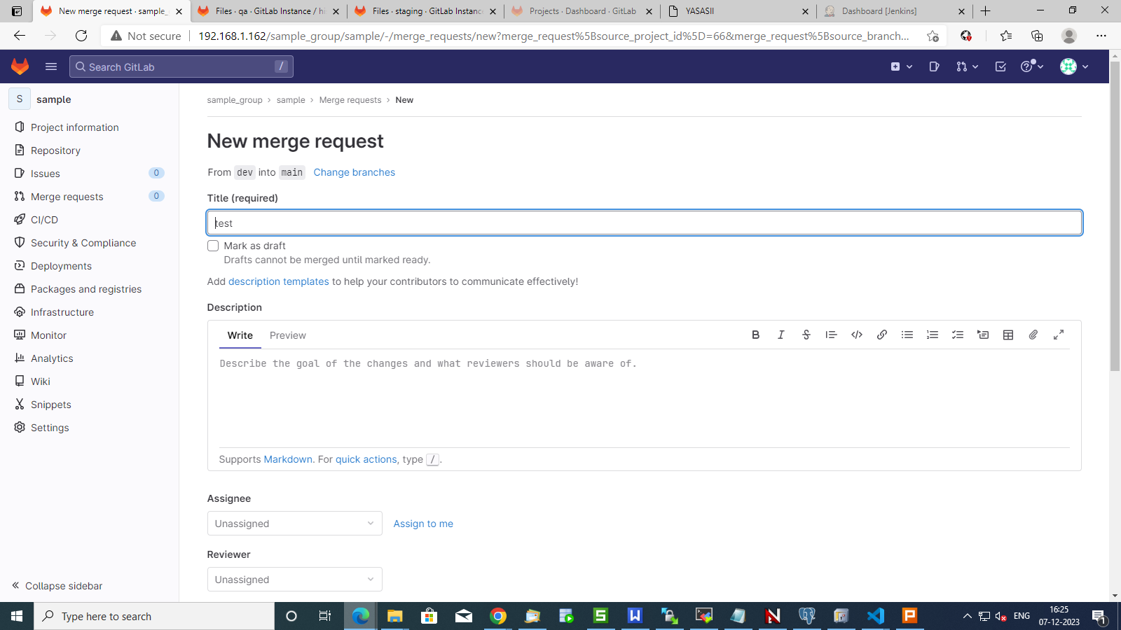
Add Title
Add description

Slide 6
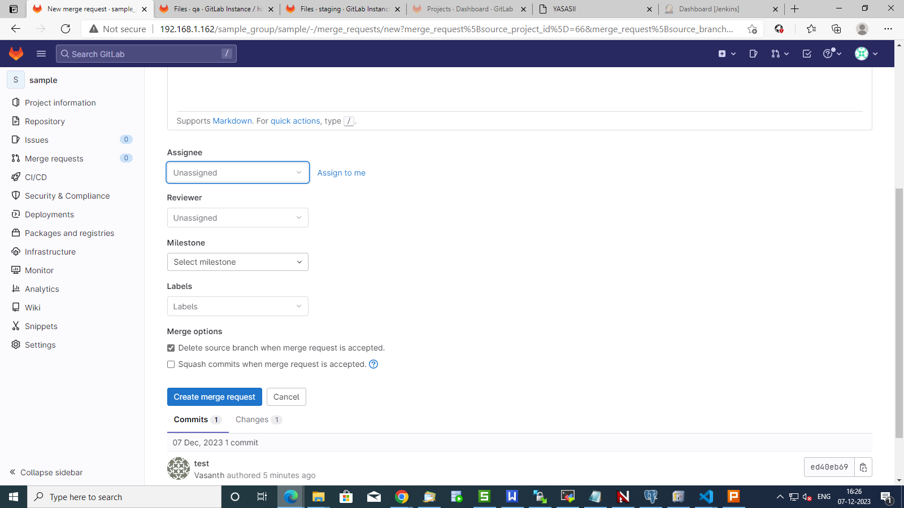
Assign to Developer
Assign to PM
Create Merge Request

Slide 7
Approving Merge Request

Slide 8
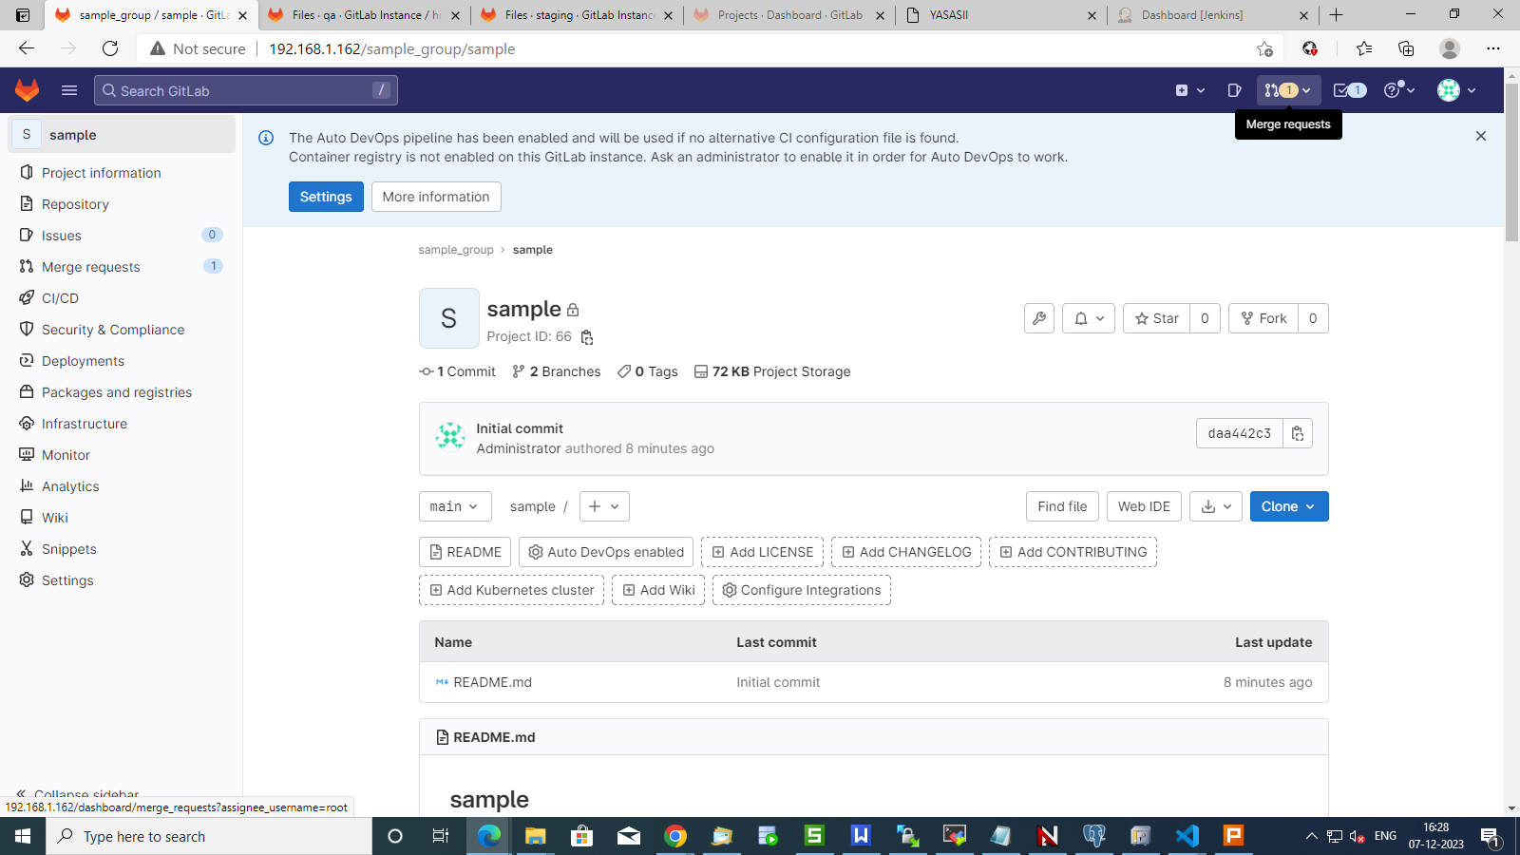

Slide 9
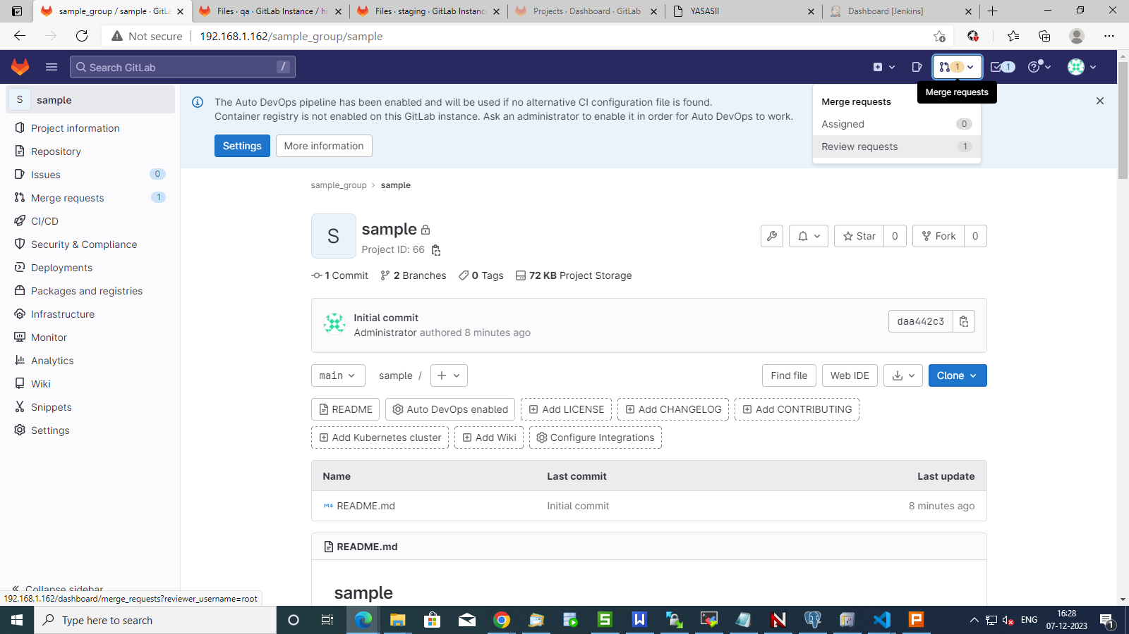

Slide 10
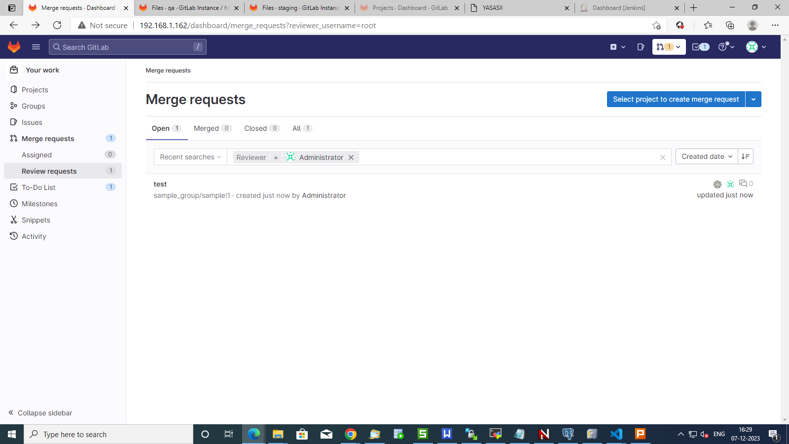

Slide 11
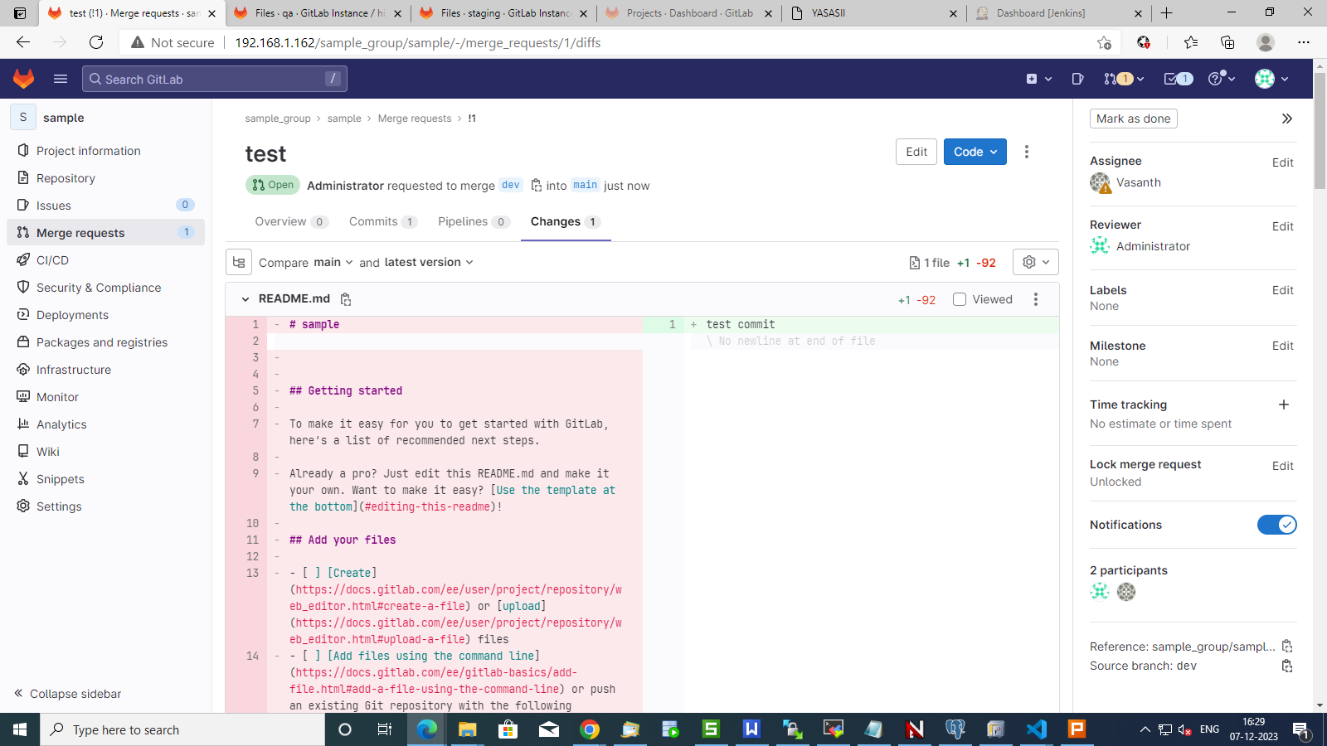
Review the changes

Slide 12
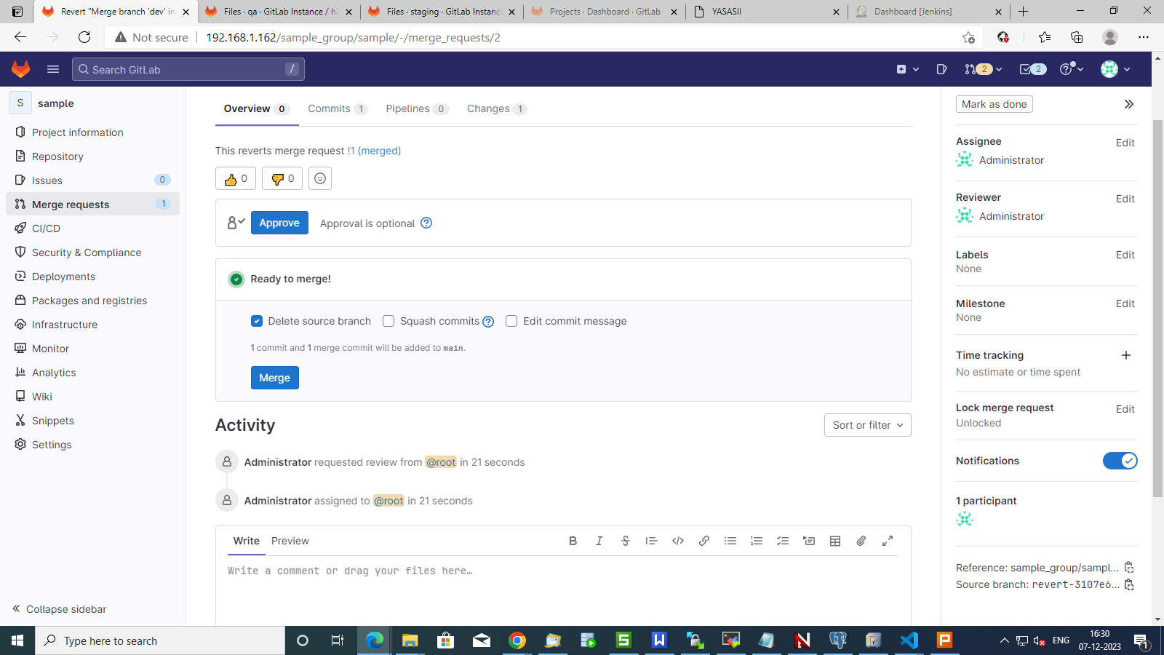

Slide 13
Thank You

